Slide 1
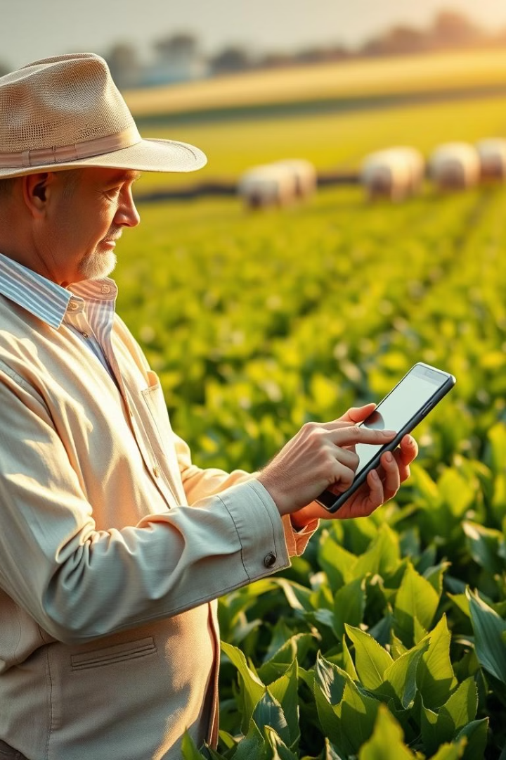
Introducing Agri Aid: Empowering Farmers with Smart Technology
Agri Aid is a helpful software tool created to improve farming. It supports farmers by giving smart advice on which crops to grow and quickly spots any plant diseases. Agri Aid works by studying the soil and using images of plants to provide useful tips and recommendations. This tool makes it easier for farmers to make good choices for their crops and keep their plants healthy.

Slide 2
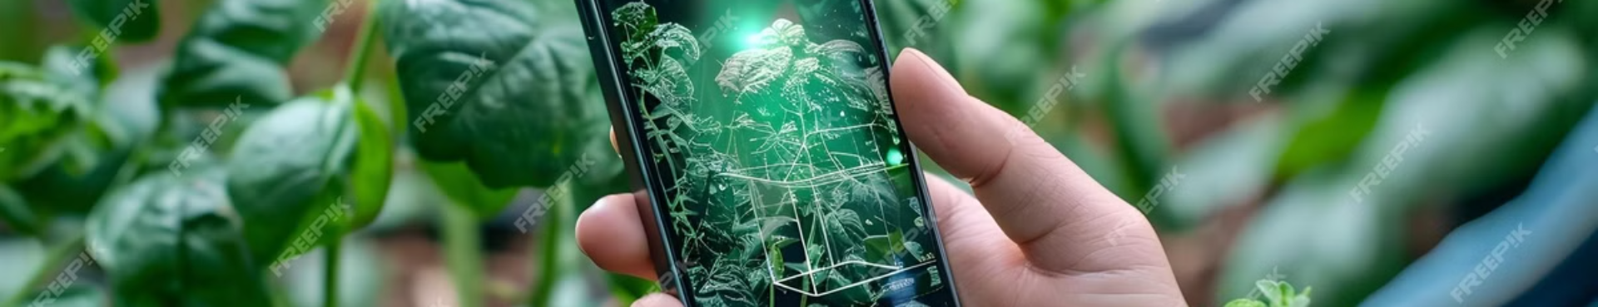
Key Features of Agri Aid
1
Soil-based Crop Recommendations
2
Disease Detection
Analyzes soil properties to suggest ideal crops.
Uses image processing to identify plant diseases from uploaded photos with detailed diagnostics.
3
Fertilizer Recommendations
4
User-friendly Interface
Analyse the soil properties and suggest a afertilizers for better growth of crops
Intuitive design makes the tool accessible to users with minimal technical expertise.

Slide 3
Sample Inputs and Outputs
Input Type
Sample Input
Sample Output
Soil Analysis
pH 6.5, medium nitrogen, high potassium
Crops: Corn, Wheat. Fertilizer: Nitrogen-based
Disease Detection
Image of tomato leaf with spots
Disease: Early Blight. Treatment: Apply fungicide
Fertilizer Suggestion
Crop type,nitrogen,pottasium,
fertilizer:urea
phosphorous

Slide 4
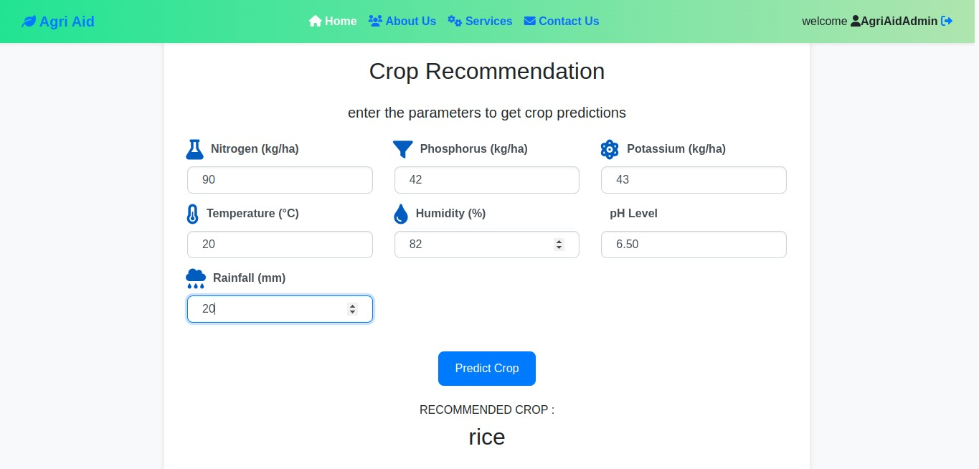

Slide 5
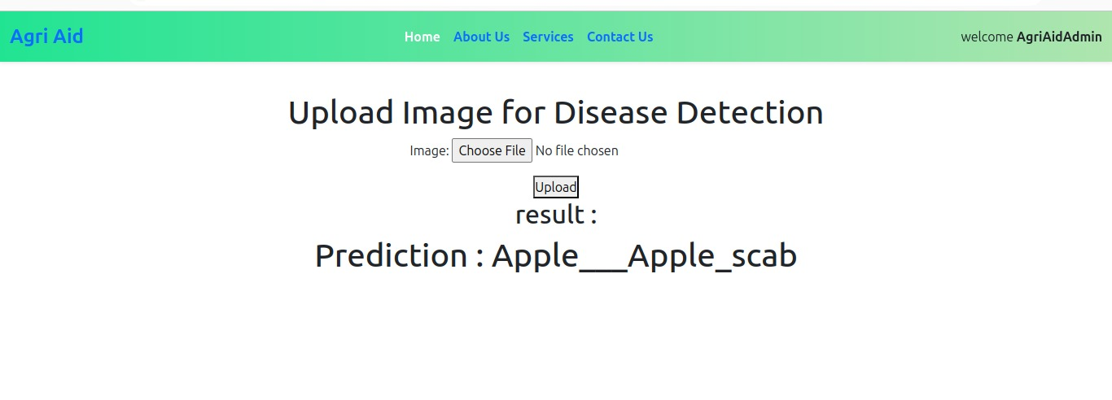

Slide 6
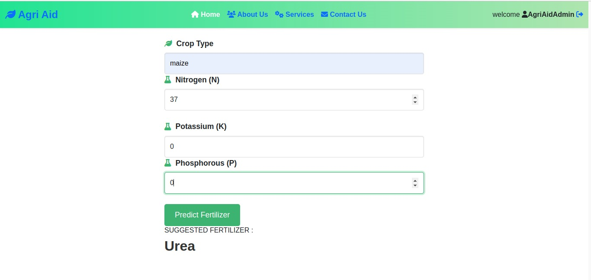

Slide 7
Advantages of Agri Aid
Precision Agriculture
Cost-Effective
Crop Protection
Provides specific crop and disease suggestions based on accurate data analysis.
Reduces the need for expensive soil and plant tests, saving farmers money.
Early disease detection minimizes crop loss and improves overall yield.

Slide 8
Disadvantages
Image Quality Dependency
Internet Connectivity
Data Limitations
Limited access in areas with poor or no internet connection.
May not recognize rare diseases or unique soil conditions.
Poor-quality images can lead to incorrect disease detection and diagnosis.
Maintenance Requirements
Needs regular updates to maintain accuracy and expand its knowledge base.

Slide 9
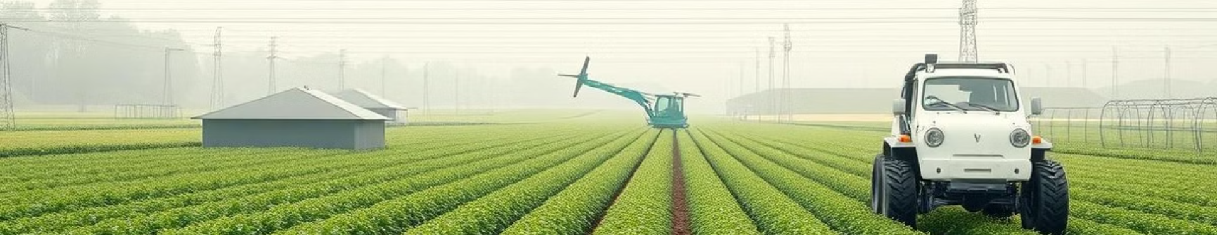



Future Scope and Enhancements
IoT Integration
Expanded Database
Mobile App Development
Implement IoT sensors for real-time soil and environmental data collection.
Add more plant species, diseases, and soil types for comprehensive coverage.
Create a dedicated mobile app for easier access and offline capabilities.

Slide 10
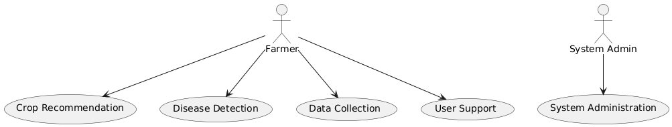
UML Diagrams Overview
Use Case Diagram
Illustrates user actions like soil input, image upload, and viewing results.

Slide 11
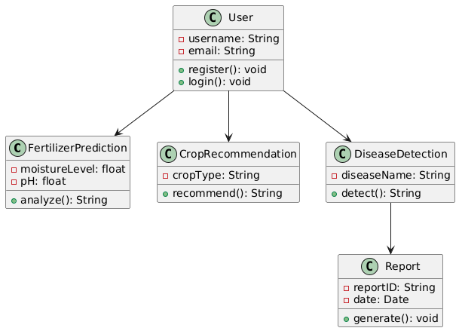
Class Diagram
Displays main components: User, Crop, Soil, and Disease Detector classes.

Slide 12
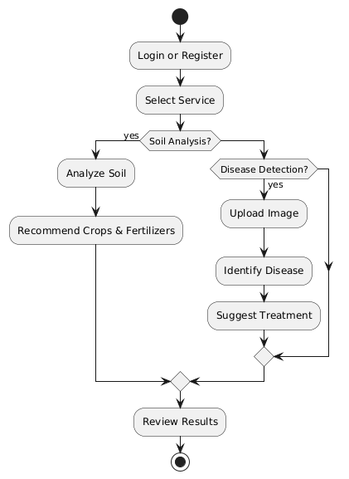
Activity Diagram
Illustrates the steps from user login to receiving crop recommendations.

Slide 13
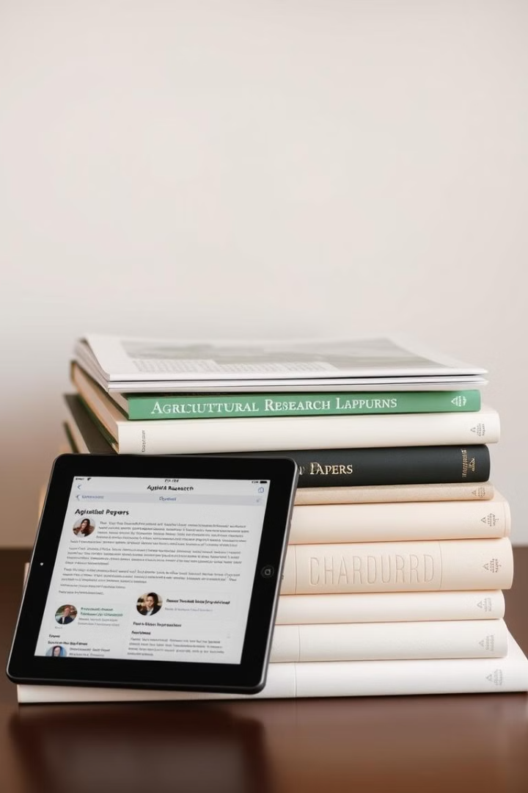
References and Resources
kaggle datasets: Machine Learning for Plant Disease Detection,fertilizer prediction,crop prediction
Django Documentation:Backend Development
W3schools

Slide 14
-Team AGRI AID
Thank You

